Slide 1
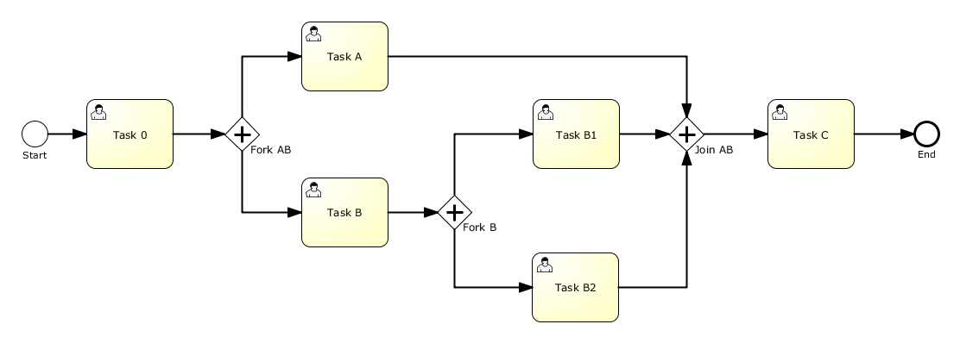

Activiti
A developer-friendly process engine
Travis Carlson
http://tcarlson.systems

Slide 2
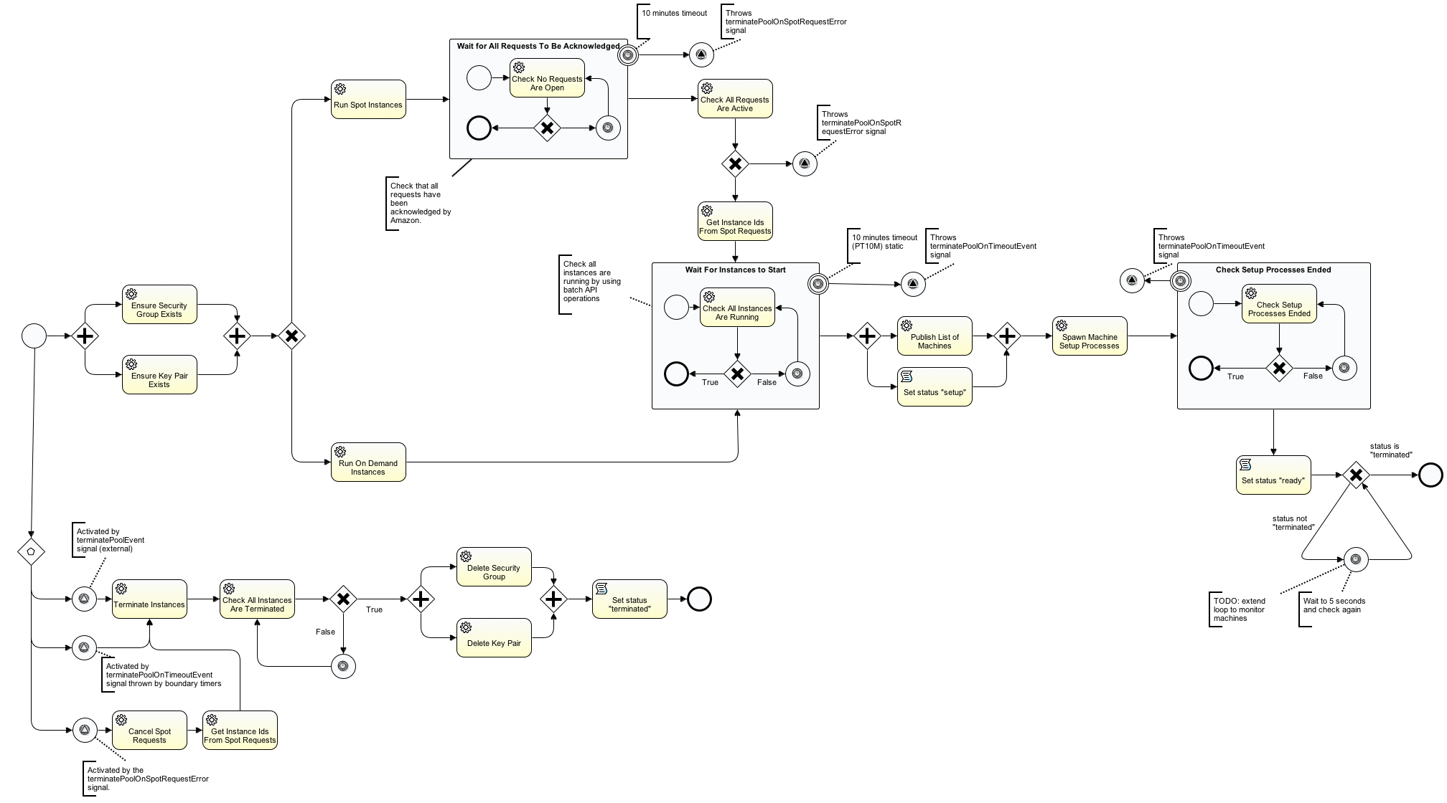
https://github.com/apache/incubator-provisionr/blob/master/README.md

Slide 3

What is it?

Slide 4
What is it?
Finite State Machine
Clean design
Simple API
Embeddable in your app
Keeps state in a database
Clusterable

Slide 5
Why would I use it?
Process-oriented applications
High-level orchestration of tasks
Mixture of human tasks & machine tasks
Batch jobs

Slide 6
More benefits
Transactional checkpoints
Audit trail
Self-documenting

Slide 7

A bit of history :
The evolution of Activiti

Slide 8



The evolution of Activiti
WS-BPEL
BPMN 2.0
JBoss → Red Hat
Alfresco
jBPM
Effektif?
Activiti
Drools
Drools Flow
jBPM

Slide 9
Demo
Installation
IDE - Build a process
Deploy
Run
Database (Audit Trail)
Java API
REST API

Slide 10


